Slide 1
ISO27001:2013 Controls Appendix; Part 5
In this module lets look at ISO27001:2013 (ISMS) related to cryptography, and physical & environmental security…

Slide 2

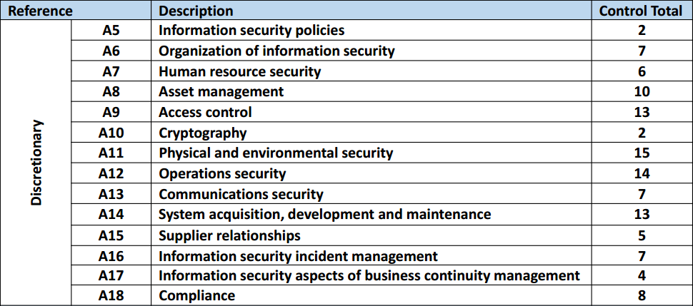
ISO27001:2013 Controls Appendix; Part 5
ISO27001:2013 DISCRETIONARY CONTROLS
TOTAL: 114
https://chapters.theiia.org/bermuda/Events/ChapterDocuments/Information%20Security%20Management%20System%20%28ISMS%29%20Overview.pdf

Slide 3
ISO27001:2013 Controls Appendix; Part 5
A.10 CRYPTOGRAPHY
A.10.1 CRYPTOGRAPHIC CONTROLS
A.10.1.1 | POLICY ON THE USE OF CRYPTOGRAPHIC CONTROLS
A.10.1.2 | KEY MANAGEMENT

Slide 4
ISO27001:2013 Controls Appendix; Part 5
A.10 CRYPTOGRAPHY
A.10.1.2 | KEY MANAGEMENT | Control: A policy on the use, protection and lifetime of cryptographic keys shall be developed and implemented through their whole lifecycle.

Slide 5
ISO27001:2013 Controls Appendix; Part 5
A.11 PHYSICAL & ENVIRONMENTAL SECURITY
A.11.1 SECURE AREAS
A.11.1.1 | PHYSICAL SECURITY PERIMETER
A.11.1.2 | PHYSICAL ENTRY CONTROLS
A.11.1.3 | SUCURING OFFICES, ROOMS, AND FACILITIES
A.11.1.4 | PROTECTING AGAINST EXTERNAL & ENVIRONMENTAL THREATS
A.11.1.5 | WORKING IN SECURE AREAS
A.11.1.6 | DELIVERY & LOADING AREAS

Slide 6
ISO27001:2013 Controls Appendix; Part 5
A.11 PHYSICAL & ENVIRONMENTAL SECURITY
A.11.1.1 | PHYSICAL SECURITY PERIMETER | Control: Security perimeters shall be defined and used to protect areas that contain either sensitive or critical info & information processing facilities.

Slide 7
ISO27001:2013 Controls Appendix; Part 5
A.11 PHYSICAL & ENVIRONMENTAL SECURITY
A.11.1.2 | PHYSICAL ENTRY CONTROLS | Control: Secure areas shall be protected by appropriate entry controls to ensure that only authorized personnel are allowed access.
A.11.1.5 | WORKING IN SECURE AREAS | Control: Procedures for working in secure areas shall be designed and applied.

Slide 8
ISO27001:2013 Controls Appendix; Part 5
A.11 PHYSICAL & ENVIRONMENTAL SECURITY
A.11.2 EQUIPMENT
A.11.2.1 | EQUIPMENT SITING & PROTECTION
A.11.2.2 | SUPPORTING UTILITIES
A.11.2.3 | CABLING SECURITY
A.11.2.4 | EQUIPMENT MAINTENANCE
A.11.2.5 | REMOVAL OF ASSETS
A.11.2.6 | SECURITY OF EQUIPMENT & ASSETS OFF-PREMISES

Slide 9
ISO27001:2013 Controls Appendix; Part 5
A.11 PHYSICAL & ENVIRONMENTAL SECURITY
A.11.2.2 | SUPPORTING UTILITIES | Control: Equipment shall be protected from power failures and other disruptions caused by failures in supporting utilities.
A.11.2.4 | EQUIPMENT MAINTENANCE | Control: Equipment shall be correctly maintained to ensure its continued availability and integrity.

Slide 10
ISO27001:2013 Controls Appendix; Part 5
A.11 PHYSICAL & ENVIRONMENTAL SECURITY
A.11.2 EQUIPMENT…
A.11.2.7 | SECURE DISPOSAL OR RE-USE OF EQUIPMENT
A.11.2.8 | UNATTENDED USER EQUIPMENT
A.11.2.9 | CLEAR DESK & CLEAR SCREEN POLICY

Slide 11
ISO27001:2013 Controls Appendix; Part 5
A.11 PHYSICAL & ENVIRONMENTAL SECURITY
A.11.2.9 | CLEAR DESK & CLEAR SCREEN POLICY | Control: A clear desk policy for papers and removable storage media and a clear screen policy for information processing facilities shall be adopted.

Slide 12
ISO27001:2013 Controls Appendix; Part 5
Lets look at operations security in the next module…
END

